Slide 1
Greedy Algorithms

Slide 2
Greedy Algorithms
Not an algorithm, But a technique.
As the name suggests, always makes the choice that seems to be the best at that moment.
It makes a locally-optimal choice in the hope that this choice will lead to a globally-optimal solution.
This method is used to solve optimization problems.

Slide 3
Greedy Approach : General Method
Algo Greedy(a,n) // Input of size n
{
for i=1 to n do // One by one go take each input. If it is feasible, include it in sol.
{
x = select(a);
if Feasible(x) Then
sol = sol + x;
}
}
In Greedy approach, we have our own method of selection and we follow it to solve the problem.

Slide 4
Fractional Knapsack
We are given n divisible objects and a knapsack.
Object i has a weight w_{i} and the knapsack has a capacity M. If a fraction x_{i}, 0<= x <= 1, of object i is placed into the knapsack then a profit of p_{i}x_{i} is earned.
The objective is to obtain a filling of the knapsack that maximizes the total profit earned.
Since the knapsack capacity is M, we require the total weight of all chosen objects to be at most M.

Slide 5
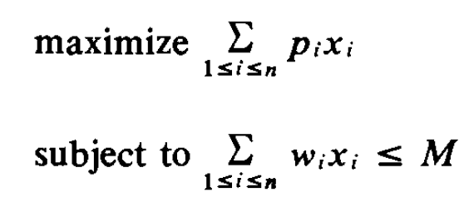
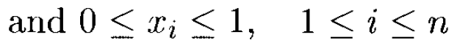
Fractional Knapsack
Formal Definition
The profits and weights are positive numbers.

Slide 6
Fractional Knapsack : Example
Objects | 1 | 2 | 3 | 4 | 5 | 6 | 7
Profit(P) | 10 | 5 | 15 | 7 | 6 | 18 | 3
Weight(W) | 2 | 3 | 5 | 7 | 1 | 4 | 1
Fill the bag(capacity=15) with the objects to maximize the profit
Several greedy strategies for the knapsack problem are possible.
In each of these strategies, the knapsack is packed in several stages. In each stage one object is selected for inclusion into the knapsack using a greedy criterion.
Methods for including the objects in the knapsack: Different Criteria
Approach 1 : Greedy on profit (Highest profit objects)
Approach 2: Greedy on weight (Lowest weight objects)
Approach 3: Highest P/W ratio.(Highest profit/kg objects)

Slide 7
Approach 1 : Greedy on profit
First possible criterion : from the remaining objects, select the object with the maximum profit that fits into the knapsack.
This strategy does not guarantee an optimal solution.
Objects | 1 | 2 | 3 | 4 | 5 | 6 | 7
Profit(P) | 10 | 5 | 15 | 7 | 6 | 18 | 3
Weight(W) | 2 | 3 | 5 | 7 | 1 | 4 | 1
Solution:(1,0,1,1,0,1) x6=4 kg, x3=5 kg, x1=2 kg, x4=4 kg
Profit = (18+15+10+4) = 47

Slide 8
Approach 2 : Greedy on weight
From the remaining objects, select the one that has minimum weight and also fits into the knapsack.
This approach does not yield in general to an optimal solution.
Objects | 1 | 2 | 3 | 4 | 5 | 6 | 7
Profit(P) | 10 | 5 | 15 | 7 | 6 | 18 | 3
Weight(W) | 2 | 3 | 5 | 7 | 1 | 4 | 1
Solution:(1,1,1,0,1,1,1) x5=1 kg, x7= 1 kg ,x1=2 kg, x2= 3kg, x6=4 kg, x3= 4 kg
Profit = (6+3+10+5+18+12) = 54

Slide 9
Approach 3 : Greedy on the profit density p_{i} /w_{i}
From the remaining objects, select the one with maximum p_{i} /w_{i} (Max profit/kg) that fits into the knapsack.
Objects | 1 | 2 | 3 | 4 | 5 | 6 | 7
Profit(P) | 10 | 5 | 15 | 7 | 6 | 18 | 3
Weight(W) | 2 | 3 | 5 | 7 | 1 | 4 | 1
P/W | 5 | 5/3 | 3 | 1 | 6 | 9/2 | 3
Solution:(x1,x2,x3,x5,x6,x7,) x5=1 kg, x1=2kg, x6=4 kg, x3=5 kg, x7=1 kg, x2=2kg,
Profit = (2*5 + 2*5/3 + 5*3 + 1*6 + 4*9/2 + 1*3 ) = 55.3

Slide 10
Example:
Consider the instance of knapsack problem where n=6, M=15, profits are (P1,P2,P3,P4,P5,P6) =(1,2,4,4,7,2) and weights are (W1,W2,W3,W4,W5,W6)=(10,5,4,2,7,3).
Find maximum profit using fractional Knapsack.

Slide 11
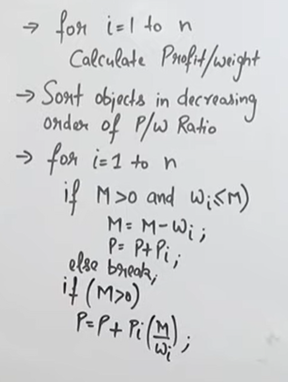
Fractional Knapsack : Algorithm
Let m=Bag capacity, n= No. of objects
Time Complexity = O(nlogn) assuming merge sort

Slide 12
Fractional Knapsack : Algorithm : Let m=Bag capacity, n= No. of objects
Algorithm: F_Knapsack(m,n)
step1: for i= 1 to n
Calculate Profit/Weight ratio.
Step2: Sort objects in decreasing order of Profit/Weight ratio.
Step3: Initialize p =0, m = given_cap.
Step4 : Do the following for every item “i” in the sorted order
for (int i = 0; i < n; i++)
{ // If adding Item won't overflow, add it completely
if (w_{i} <= m) {
m = m - w_{i};
p = p + p_{i};
}
// If we can't add current Item, add fractional part of it
else {
p = p + ( p_{i} / w_{i} );
break;
}
return p;

Slide 13
0/1 Knapsack Problem
In the 0/1 knapsack problem, we wish to pack a knapsack (bag or sack) with a capacity of C.
From a list of n nondivisible items, we must select the items that are to be packed into the knapsack.
Either include whole object or don’t include it. A fraction of the object cannot be included in the bag.

Slide 14
Pros and Cons
It is quite easy to come up with a greedy algorithm (or even multiple greedy algorithms) for a problem.
Analyzing the run time for greedy algorithms will generally be much easier than for other techniques.
The difficult part is that for greedy algorithms you have to work much harder to understand correctness issues. Even with the correct algorithm, it is hard to prove why it is correct.

Slide 15
Point to Ponder
The 0/1 knapsack problem is an NP-hard problem. This is the reason why we cannot find a polynomial-time algorithm to solve it.

Slide 16
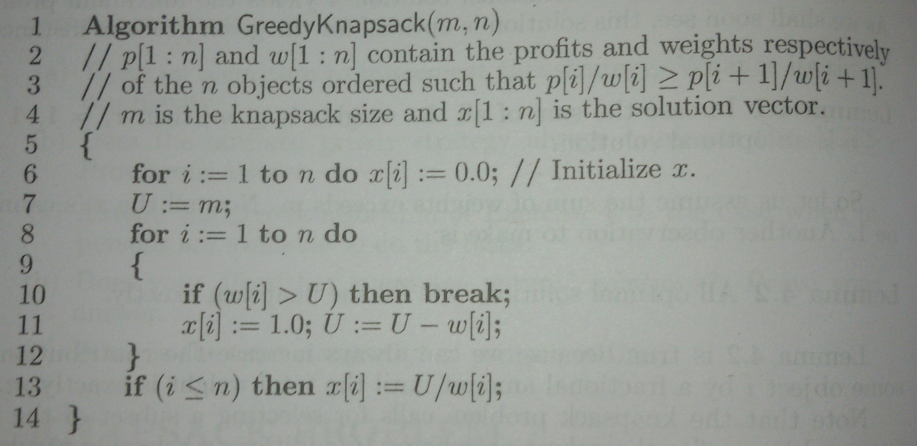
Fractional Knapsack : Algorithm

Slide 17
Job Sequencing with Deadlines

Slide 18
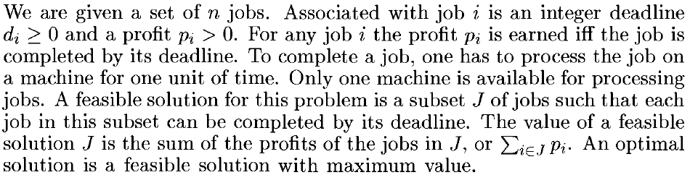
Job Sequencing with Deadlines : Problem
Assumptions:
There is a single machine. Each job should be processed on it.
On a machine , each job needs one unit of time for completion.
No preemption.

Slide 19
Job Sequencing with Deadlines : Problem
Assumptions:
There is a single machine. Each job should be processed on it.
On a machine , each job needs one unit of time for completion.
No preemption.

Slide 20
Example
Find the order in which jobs should be completed so that profit will be maximized.
Job | J1 | J2 | J3 | J4 | J5
Profit | 20 | 15 | 10 | 5 | 1
Deadline | 2 | 2 | 1 | 3 | 3
Maximum deadline = No. of slots available = 3
Solution:
(J2 ,J1 ,J4) or (J1, J2, J4) Profit= 40

Slide 21
Example
n = 7
p = [35,30,25,20,15,12,5]
d = [3,4,4,2,3,1,2]
(J4,J3,J1,J2) Profit= 110

Slide 22
Example
Given a set of 9 jobs (J1,J2,J3,J4,J5,J6,J7,J8,J9) where each job has a deadline (5,4,3,3,4,5,2,3,7) and profit (85,25,16,40,55,19,92,80,15) associated to it .
Each job takes 1 unit of time to complete and only one job can be scheduled at a time. We earn the profit if and only if the job is completed by its deadline. The task is to find the maximum profit and the number of jobs done.

Slide 23
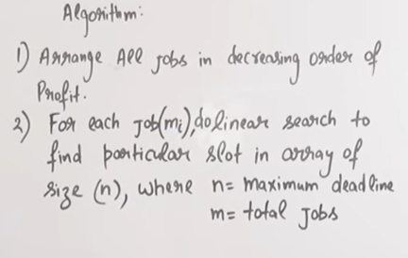
Job Sequencing with Deadlines :Algorithm and TC:
Time complexity = O(n²) assuming quicksort algorithm

Slide 24
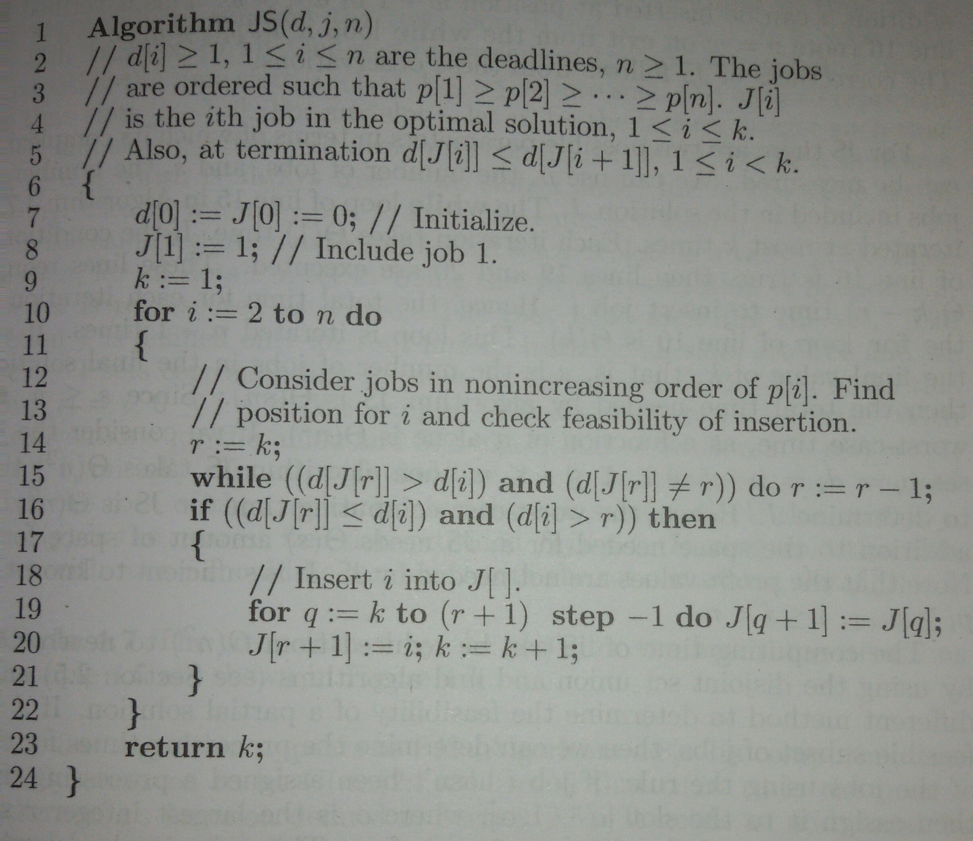
Algorithm

Slide 25
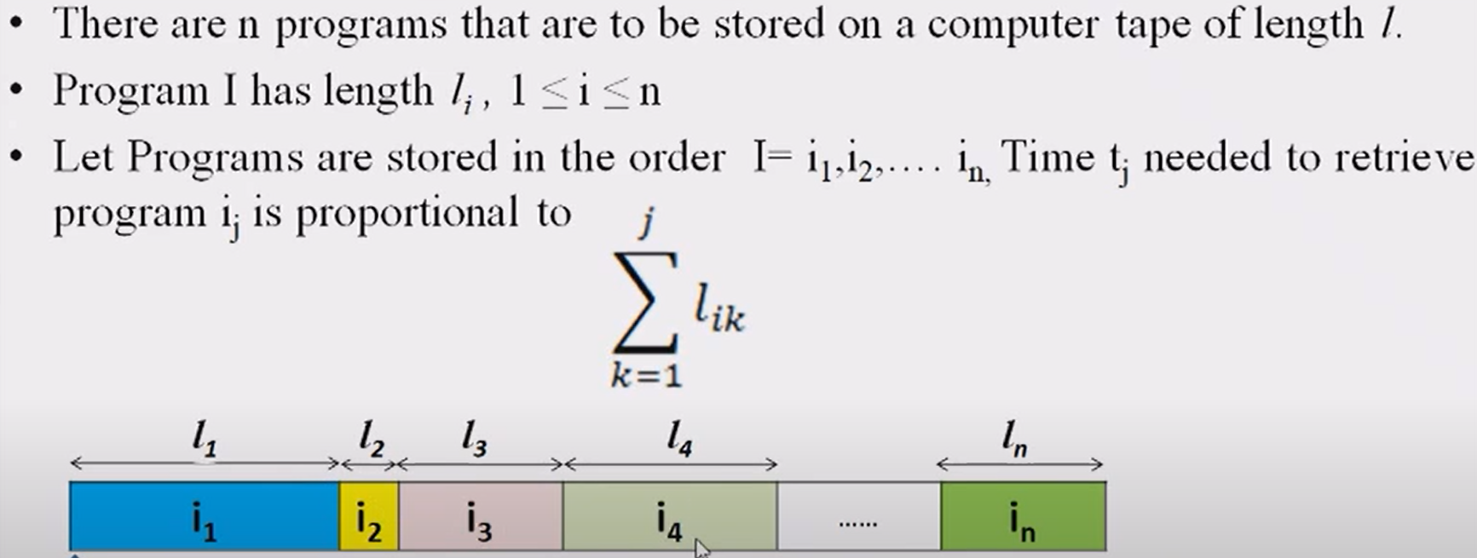
Optimal Storage on the Tape

Slide 26
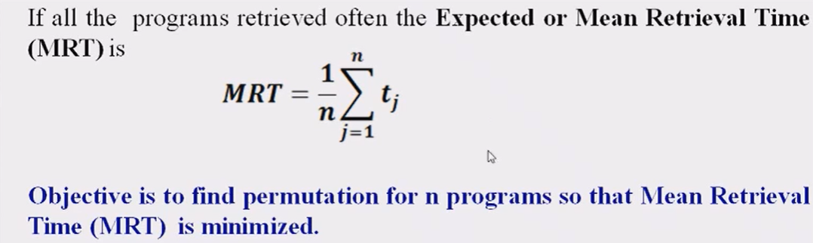
Optimal Storage on the Tape

Slide 27
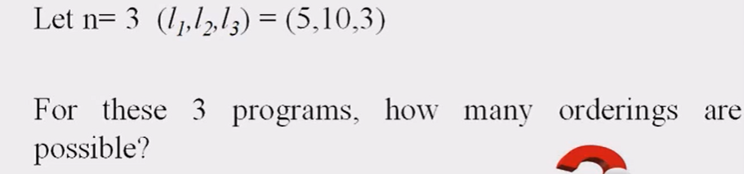
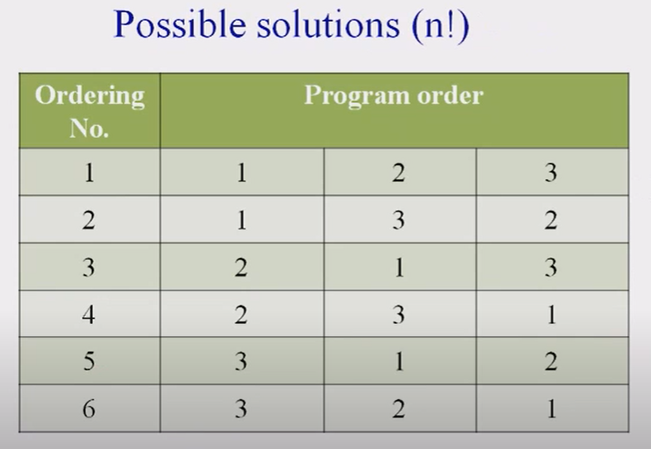
Optimal Storage on the Tape

Slide 28
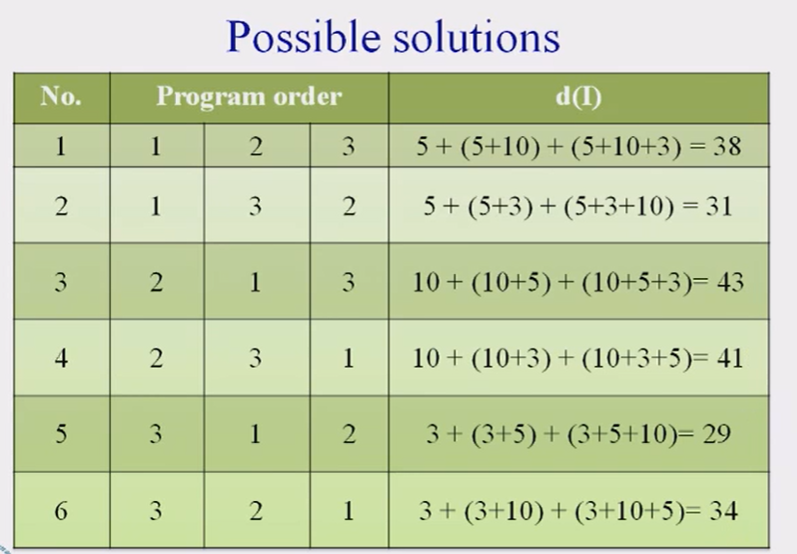
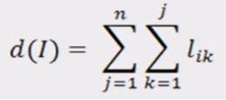
Optimal Storage on the Tape
Total retrieval time of all programs.

Slide 29
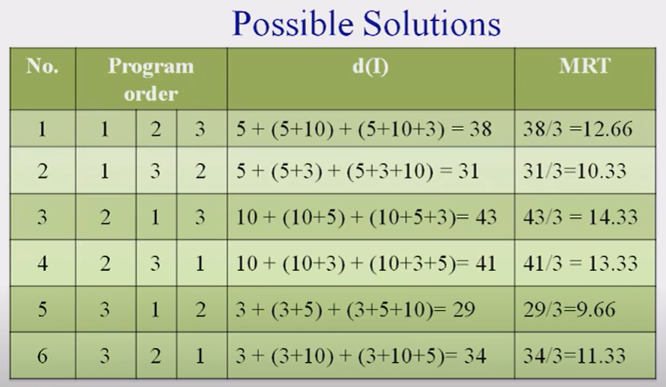

Optimal Storage on the Tape

Slide 30
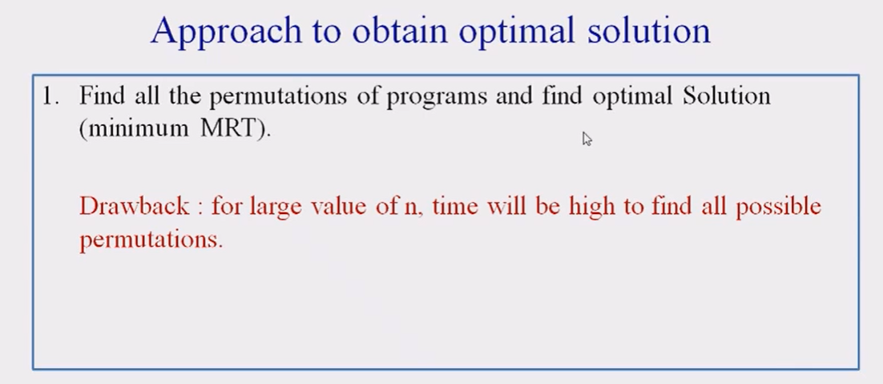
Optimal Storage on the Tape

Slide 31
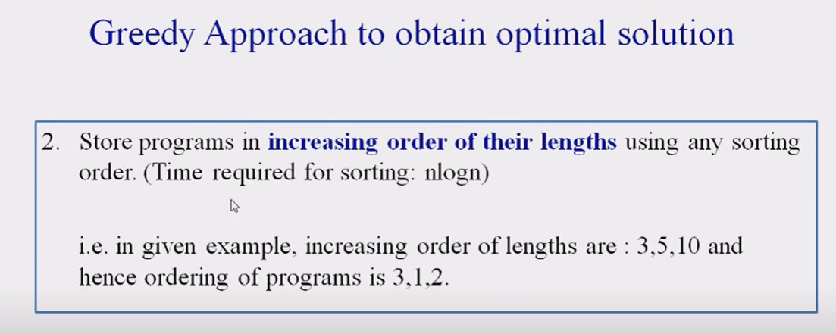
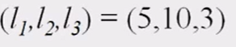
Optimal Storage on the Tape

Slide 32
Example: Find ORT for 8 programs with lengths 12,5,8,32,7,5,8,13
Arrange programs in ascending order of their lengths: 5,5,7,8,8,12,13,32 (p2,p6,p5,p3,p7,p1,p8,p4)
Optimal order: p2,p6,p5,p3,p7,p1,p8,p4
Total RT = 5 + (5+5) + (5+5+7) + (5+5+7+8) + (5+5+7+8+8)+(5+5+7+8++8+12)+ (5+5+7+8+8+12+13) + (5+5+7+8+8+12+13+32)
Mean RT= 230/8

Slide 33
Optimal Storage on the Tapes: More than 1 tape
Example : Find total RT for following programs with 3 tapes T0,T1,T2
5,8,32,7,5,18,13,12.
Solution:
Step 1: Arrange programs in ascending order of their lengths: 5,5,7,8,12,13,18,32
Step 2: Assign programs to three tapes T0,T1 and T2
T0: 5 8 18
T1: 5 12 32
T2: 7 13
Step 3: Total RT for T0 = 5 + (5+8) + (5+8+18) = 49
Total RT for T1 = 5 + (5+12) + (5+12+32) = 71
Total RT for T2 = 7 + (7+13) = 27
Total RT for 3 tapes= 147
Mean RT=147/3

Slide 34
Algorithm and Time Complexity
void findOrderMRT(int L[], int n)
{
// Here length of i'th program is L[i]
sort(L, L + n);
// Lengths of programs sorted according to increasing
// lengths. This is the order in which the programs
// have to be stored on tape for minimum MRT
cout << "Optimal order in which programs are to be"
"stored is: ";
for (int i = 0; i < n; i++)
cout << L[i] << " ";
cout << endl;
// MRT - Minimum Retrieval Time
double MRT = 0;
for (int i = 0; i < n; i++) {
int sum = 0;
for (int j = 0; j <= i; j++)
sum += L[j];
MRT += sum;
}
MRT /= n;
cout << "Minimum Retrieval Time of this"
" order is " << MRT;
}

Slide 35
Algorithm and Time Complexity
void findOrderMRT(int L[], int n)
{
// Here length of i'th program is L[i]
sort(L,n);
// Lengths of programs sorted according to increasing
// lengths. This is the order in which the programs
// have to be stored on tape for minimum MRT
cout << "Optimal order in which programs are to be"
"stored is: ";
for (int i = 0; i < n; i++)
cout << L[i] << " ";
cout << endl;
// MRT - Minimum Retrieval Time
double MRT = 0;
for (int i = 0; i < n; i++) {
int sum = 0;
for (int j = 0; j <= i; j++)
sum += L[j];
MRT += sum;
}
MRT /= n;
cout << "Minimum Retrieval Time of this"
" order is " << MRT;
}
O(nlogn)
O(n)
O(n²)

Slide 36

Algorithm and Time Complexity
Algorithm findOrderMRT(L,n)
Step 1: Sort array in ascending order
Step 2: // MRT - Mean Retrieval Time
MRT = 0;
for (int i = 0; i < n; i++) {
int sum = 0;
for (int j = 0; j <= i; j++)
sum += L[j];
MRT += sum;
}
MRT /= n;
cout << "Minimum Retrieval Time of this"
" order is " << MRT;
}
O(nlogn)
O(n²)
for (int i = 0; i < n; i++)
MRT += (n - i) * L[i];
O(n)
Time complexity of O(n²) or O(nlogn)

Slide 37
Example
Example: Given the program lengths L = {12, 34, 56, 73, 24, 11, 34, 56, 78, 91, 34, 91, 45}. Store them on three tapes and minimize MRT

Slide 39

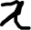

Optimal Merge Pattern
How to merge 2 sorted lists?
How to merge 4 sorted lists using 2 way merge?
Lists A,B,C,D with sizes 6, 5, 2 , 3
Optimal Merge Pattern: Always merge two small sized lists first
Example:
Lists : x1, x2, x3, x4, x5
Sizes: 20, 30, 10, 5, 30
Find optimal merge pattern (pattern with minimum merging cost)
Total Cost =

Slide 40
Huffman Coding
Example Message: BCCABBDDAECCBBAEDDCC (20 letters msg)
1. Using ASCII Codes: ASCII codes are 8 bits. So Size of example message encoded using ASCII codes= 8 x 20 =160 bits
2. Fixed Size Coding: Using our own codes instead of ASCII codes.
Our Example Message includes only 5 characters(A to E). So I can use 3 bits to represent 5 characters.
E.g., for the example message , alphabet A can be encoded as 000, B->001, C->010, D->011, E->100
Hence Size of encoded message: 3 x 20= 60 bits.
But the characters are not always A,B,C,D,E,F . They can be any 5 characters e.g A,M,N,O,P. or any other. So how can receiver know which code is for which character?
So along with encoded message , a table is required to decode the message and this table should include 8 bit ASCII code of each character along with its 3 bit code.
So, Size of table=8 x 5 + 3 x 5= 55 bits
Hence total 115 (60 +55) bits are required with Fixed size coding.
The size of encoded example message reduced to 115 from 160.

Slide 41
3. Huffman Coding : Variable Size Coding:
Message: BCCABBDDAECCBBAEDDCC (20 letters msg)
Instead of giving fixed size codes for all characters , if we give small size codes for the characters that are appearing more no. of times , then the size of the entire message will be definitely reduced.
H.Code follows optimal merge pattern.
To generate variable size codes :
Arrange the alphabets in the increasing order of their counts and draw optimal merge pattern tree.
On LHS of each node mark 0 and on RHS mark 1.
Character | Count | Code | No. of bits
A | 3 | 111 | 3 x 3=9
B | 5 | 00 | 5 x 2=10
C | 6 | 01 | 6 x 2=12
D | 4 | 10 | 4 x 2 =8
E | 2 | 110 | 2 x 3 =6
Message Size | = |  | 45 bits
Character | Count
A | 3
B | 5
C | 6
D | 4
E | 2

Slide 42
3. Huffman Coding : Variable Size Coding (Cntd…)
Along with the encoded message, the encoding tree or table should also be sent to the receiver . Then only decoding can be possible.
This table will include 8 bits ASCII codes for all 5 characters(=40 bits) and 12 bits for the H.codes. Table size=(40+12)=52 bits
So Variable size coding for this example requires 45(message size) +52 =97 bits .

Slide 43
Examples: 1. Explain Huffman Algorithm. Construct a Huffman Tree and find Huffman code for the message: KARNATAKA 2. Explain Huffman Algorithm. Construct a Huffman Tree and find Huffman code for the message: MAHARASHTRA
3. What is the optimal Huffman code for the following set of frequencies, based on the first 8 Fibonacci numbers?
a:1 b:1 c:2 d:3 e:5 f:8 g:13 h:21

Slide 44
END

